Slide 1
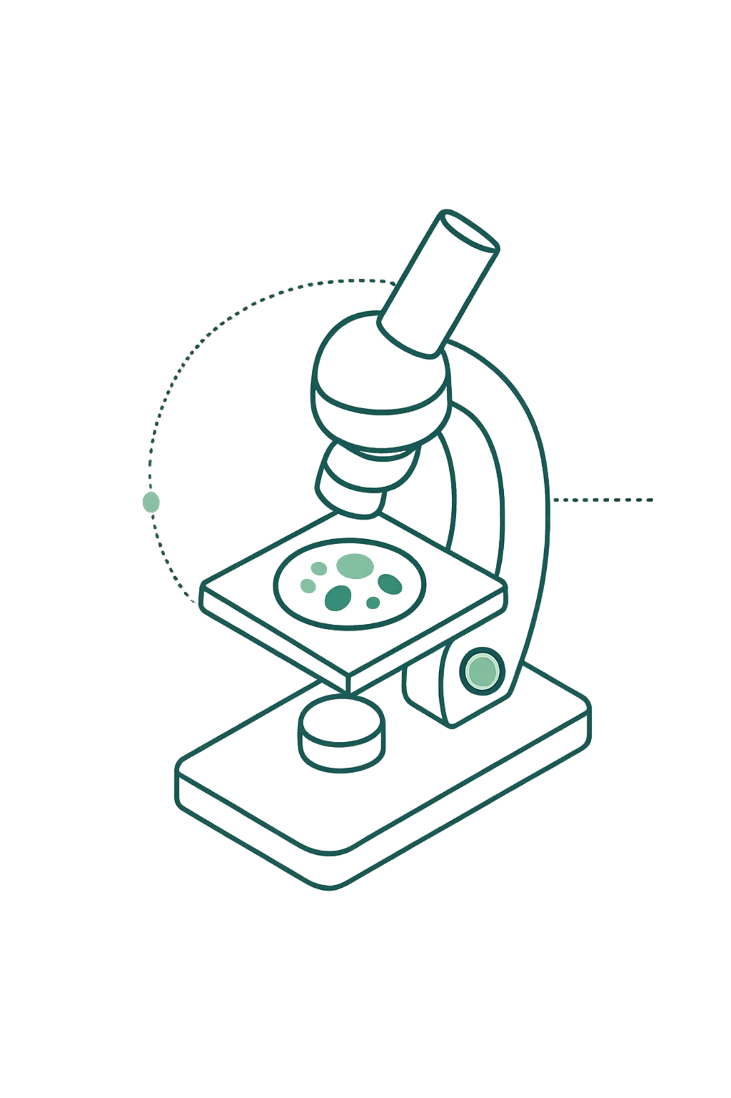

Abnormal Cervical Cell Detection: Revolutionizing Screening with ML and CNNs
Deep learning models like Convolutional Neural Networks are transforming early cervical cancer detection, enabling faster, more accurate screening through automated image analysis.

Slide 2

The Silent Threat: Cervical Cancer's Global Impact
Significant Mortality
Early Detection Matters
Cervical cancer remains a leading cause of death among women worldwide, particularly in underserved regions.
Timely identification dramatically improves survival rates and treatment outcomes.
Expert-Dependent Methods
Traditional Pap smears and biopsies rely on skilled pathologists, introducing variability and potential human error.

Slide 3


The Challenge: Bridging the Gap in Screening
Resource Limitations
Developing countries face severe shortages of trained pathologists and laboratory equipment, limiting access to screening programs.
Manual Screening Bottlenecks
Manual examination is time-intensive and prone to fatigue-related errors, leading to potential misdiagnosis and delayed treatment.
Scalability Needs
There's an urgent need for automated diagnostic tools that are robust, accurate, and can scale to serve millions of women globally.

Slide 4


Introducing CerviXpert: A New Era in Detection
98.04%
SiPaKMeD
Classification Accuracy
Dataset Source
Exceptional performance in distinguishing abnormal cervical cells
Publicly available annotated image collection
CNN
Architecture
Multi-structural Convolutional Neural Network
CerviXpert represents a breakthrough in automated cervical cell analysis. This multi-structural CNN model balances computational efficiency with exceptional accuracy, leveraging the SiPaKMeD dataset to achieve 98.04% accuracy in classifying cervical cell abnormalities.

Slide 5
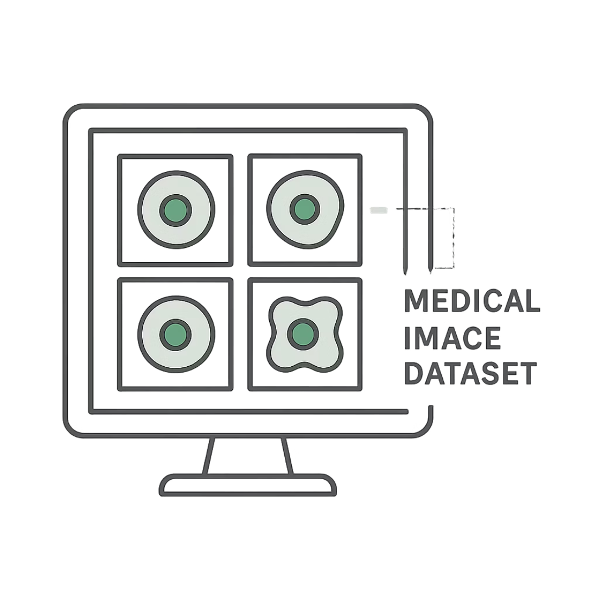


Powering Detection: Large Annotated Datasets are Key
The development of reliable AI models depends entirely on comprehensive, well-annotated datasets. Scientific Data published a groundbreaking dataset in 2025 containing 8,037 annotated images of cervical cells.
These meticulously labeled images serve as the foundation for training robust CNNs, enabling models to learn subtle visual patterns that distinguish normal from abnormal cells with high precision.

Slide 6
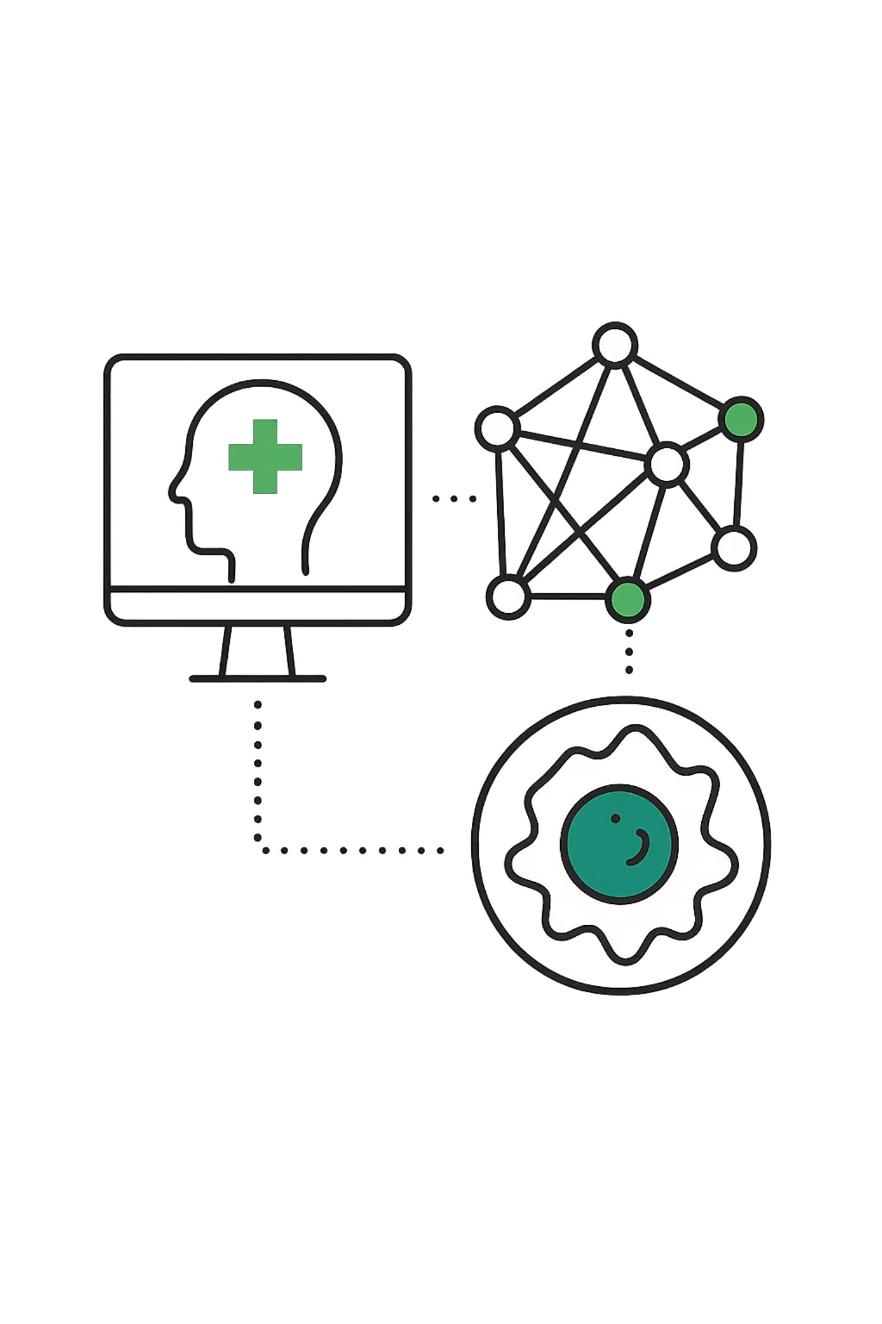

CNNs in Action: How They Detect Abnormal Cells
Visual Pattern Recognition
CNNs excel at identifying complex patterns in images through multiple layers of processing.
Feature Extraction
Models automatically learn to extract relevant features from Pap smear images at different scales and resolutions.
Classification Power
Deep networks like ResNet50, VGG16, MobileNetV2, and InceptionV3 achieve exceptional accuracy in distinguishing cell types.

Slide 7
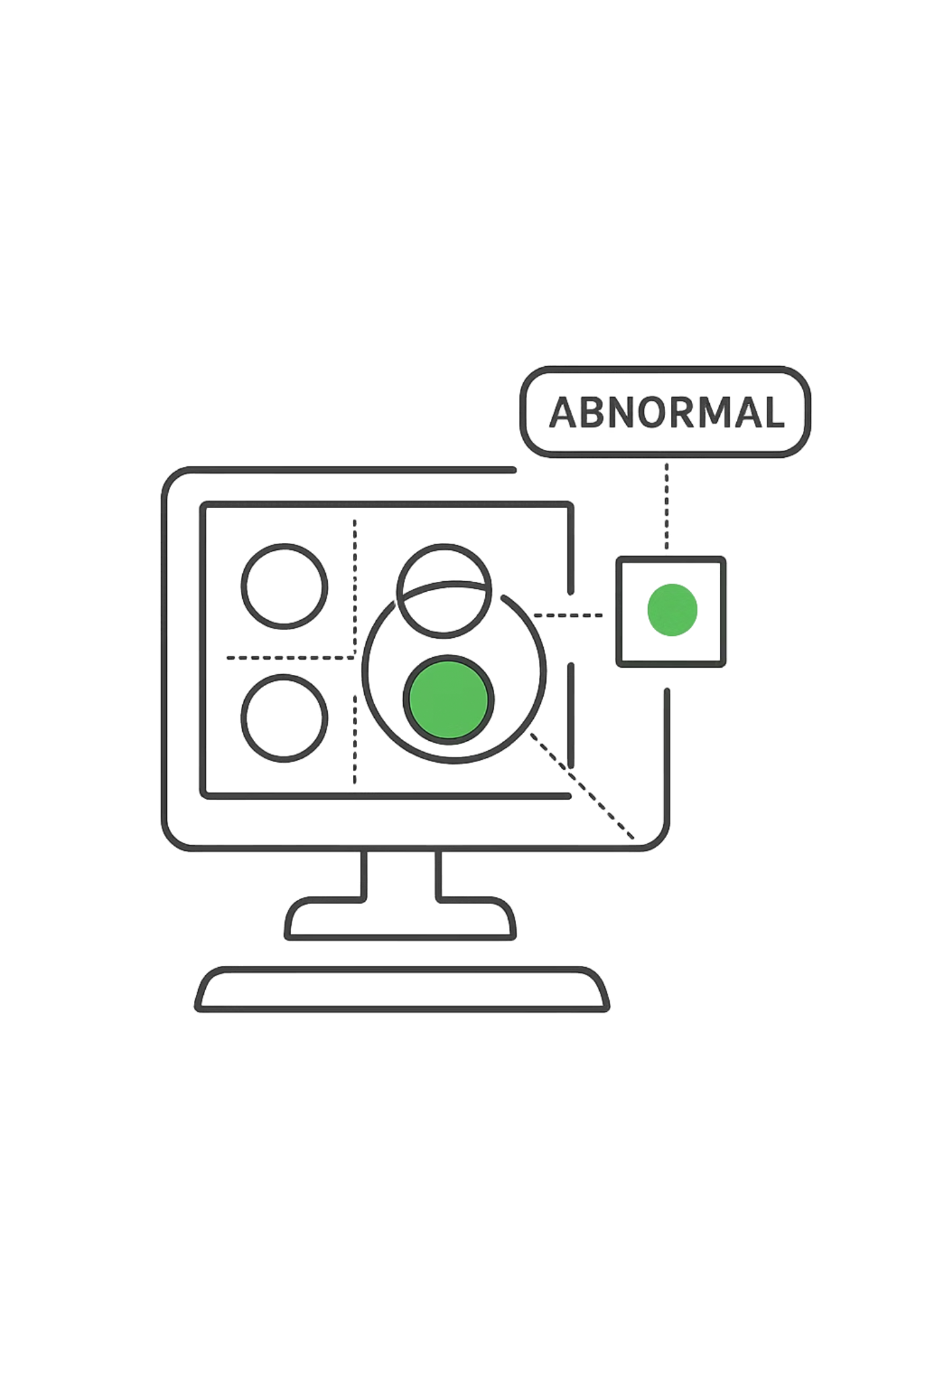
Beyond Basic Classification: Advanced CNN Applications
Whole Slide Image Analysis
1
Advanced systems analyze entire microscopic slides, not just individual cells, providing comprehensive screening.
High Sensitivity & Specificity
2
Nature Communications (2021) reported systems achieving 93.5% Specificity and 95.1% Sensitivity.
Lesion Highlighting
3
CNNs can pinpoint and highlight suspicious lesion cells while classifying lesion severity, guiding pathologist review.

Slide 8
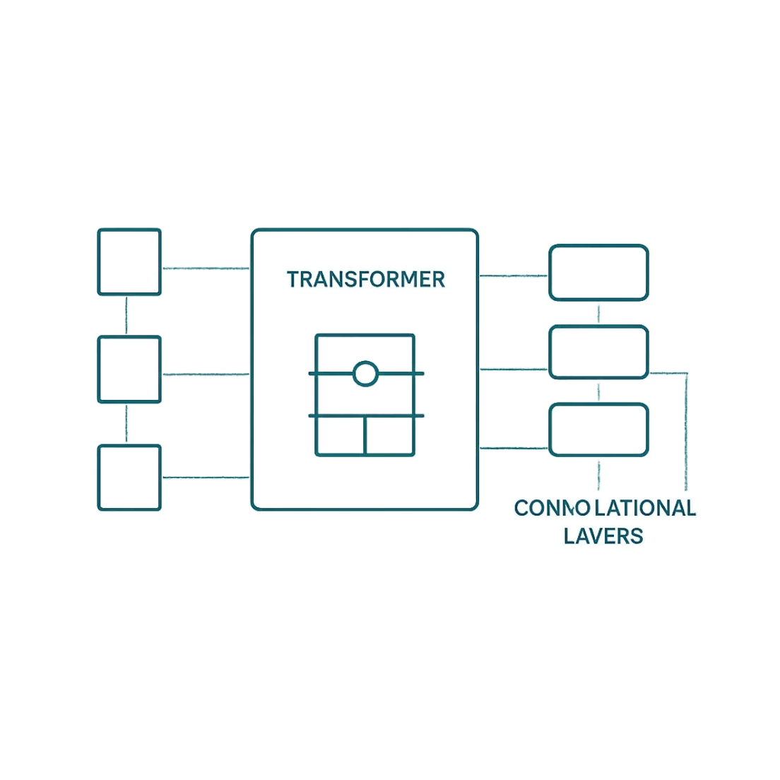

Hybrid Approaches for Enhanced Accuracy
CVM-Cervix Framework
This innovative approach combines CNNs with Visual Transformers and Multilayer Perceptrons to extract both local and global features.
The hybrid architecture captures fine-grained cellular details while understanding broader tissue context, enabling more comprehensive analysis.
This framework demonstrates effectiveness and potential for rapid, accurate Pap smear image classification, outperforming traditional CNN-only approaches.

Slide 9





Real-World Impact: Speed, Accuracy, and Accessibility
Rapid Reporting
Generate diagnostic reports in minutes instead of days
High Sensitivity
Up to 99.4% sensitivity in large-scale validation studies
Global Access
Overcome resource shortages to serve underserved populations
CNN-based models significantly reduce pathologist workload while maintaining diagnostic accuracy. These advancements promise to overcome shortages in medical resources and improve global access to life-saving screening.

Slide 10


The Future of Cervical Cancer Screening: AI-Powered Precision
Transforming Diagnosis
Continuous Improvement
Machine learning and deep learning are revolutionizing early cancer detection across all medical specialties.
Larger datasets and refined CNN architectures will further enhance accuracy and reliability.
Eradicating Cervical Cancer
AI-driven screening offers a clear path toward eliminating cervical cancer through early detection and timely treatment.

